Slide 1

Buzz Wire Game
Harmi Mathukiya 21104044
Avantika More 21104033
Atharva Mohape 21104121

Slide 2
Contents
Introduction
Problem Statement
Objectives
Scope
State Diagram/Workflow
Circuit Diagram
Hardware and Software Requirement
Project Timeline
Conclusion
References

Slide 3
1. Introduction
Buzz Wire has become a popular game across the world, with variations found in arcades, amusement parks, and toy stores.
Buzz wire game is a popular and entertaining skill game that challenges players to navigate a metal loop along a twisted wire without touching the wire.
The buzz wire game is a classic example of a simple yet addictive game that has been enjoyed by people of all ages for many years.
Buzz wire game is a classic and exciting game that challenges your hand-eye coordination and steady hand skills.

Slide 4
2. Problem Statement
Buzz wire games are often designed without considering the needs and abilities of people with disabilities, excluding them from the fun and challenges of the game.
There is often a lack of variation and creativity in the designs of buzz wire games, leading to boredom and disinterest among players.
The effectiveness of buzz wire games as a tool for teaching or promoting certain skills or concepts is still an open question, with more research needed to fully understand their potential benefits and limitations.

Slide 5
3. Objectives
To learn and understand connections involved in Buzz Wire Game.
To know functions and applications of Buzzer.
The objective of Buzz wire game is mainly to create awareness about indoor games in today's youngsters and encourage them to play such games.

Slide 6
4. Scope
Gaming: The Buzz wire game is a classic and entertaining game that has been enjoyed by people of all ages for many years. The game can be adapted to different levels of difficulty, making it suitable for players of different skill levels.
Education: The Buzz wire game is an excellent tool for teaching and improving hand-eye coordination, concentration, and fine motor skills.
Medical: The game could be used in medical schools to teach students about the importance of steady hands and concentration in medical procedures.

Slide 7
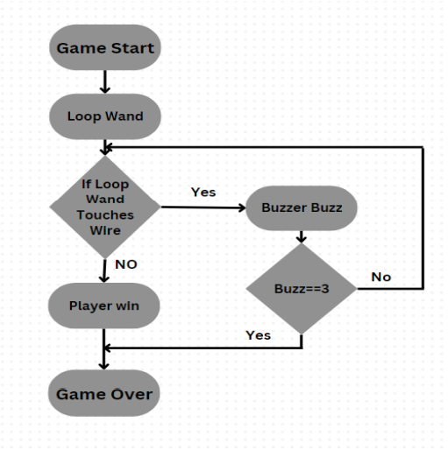
5. Circuit Diagram

Slide 8
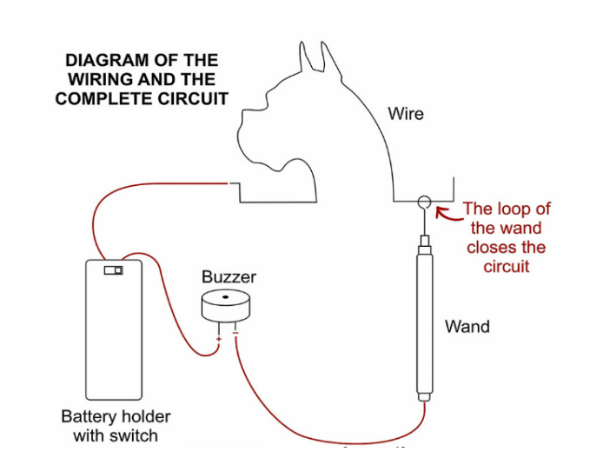
6. Circuit Diagram

Slide 9
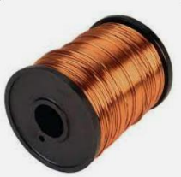

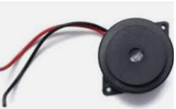
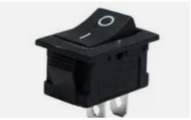
7. Hardware and Software Requirement
Copper Wire
9V Battery
Cardboard
Buzzer
ON/OFF Switch

Slide 10
8. Project Timeline
Sr.no | Group members | Time Duration | Work to be done
1. | Harmi Mathukiya Avantika More Atharva Mohape | 3rd and 4th week of January | Topic finalization and requirements gathering.
2. | Harmi Mathukiya Avantika More Atharva Mohape | 1st and 2nd week of February. | Implementing the circuit design.
3. | Harmi Mathukiya Avantika More Atharva Mohape | End of February and 1st week of March. | Connecting the components.
4. | Harmi Mathukiya Avantika More Atharva Mohape | By the end of March. | Final testing and resolving issues if any.

Slide 11
9. Conclusion
In conclusion, the buzz wire game is a fun and challenging game that has been popular for decades. It is a great way to improve hand-eye co-ordination, concentration, and patience.Person playing this can gather concentration power, patience to deal with the ring loop and also get creative in terms of cracking the level.If you are looking for a fun and challenging game to improve your skills, the buzz wire game is definitely worth trying.

Slide 12
References
"Buzz Wire Game: A Review" by G. P. M. Arachchi and H. M. W. P. Herath, published in the International Journal of Computer Applications in 2017.
"Buzz Wire Game: A Review" by G. P. M. Arachchi and H. M. W. P. Herath, published in the International Journal of Computer Applications in 2017.
"A Literature Review on the Design and Implementation of Buzz Wire Games" by Xin Wang, Xiaojiang Du, and Xiaodong Li, published in the Journal of Physics: Conference Series in 2020.
https://nuttyscientists.com/southeast-michigan/wp-content/uploads/sites/15/2020/11/Buzz-Wire.pdf

Slide 13
Thank You...!!

